Slide 1


Tianyang Wang
https://github.com/williamwang-ty/ibm-ds-capstone
27/05/2025

Slide 2

Outline
Executive Summary
Introduction
Methodology
Results
Conclusion
Appendix

Slide 3
Executive Summary
Collected data from the public SpaceX API and the SpaceX Wikipedia page. Created a label column named 'class' to categorize successful landings. Explored the data using SQL, visualizations, Folium maps, and dashboards. Selected relevant columns to be used as features. Converted all categorical variables to binary using one-hot encoding. Standardized the data and utilized GridSearchCV to identify the best parameters for machine learning models. Visualized the accuracy scores of all models.
Developed four machine learning models: Logistic Regression, Support Vector Machine, Decision Tree Classifier, and K Nearest Neighbors. All models yielded similar results with an accuracy rate of approximately 83.33%. Each model tended to over-predict successful landings. More data is required to improve model performance and accuracy.

Slide 4
Introduction
Background: The Commercial Space Age The commercial space industry is booming, with SpaceX leading through competitive pricing at $62 million per launch compared to the industry average of $165 million USD. This edge comes from their ability to recover and reuse the first stage of rockets. Space Y seeks to rival SpaceX by adopting similar recovery techniques.
Problem: Machine Learning for Stage 1 Recovery Space Y has commissioned us to build a machine learning model to predict the successful recovery of their rocket's first stage, a key step to optimize operations and cut costs in competing with SpaceX.

Slide 5

Section 1

Slide 6
Methodology
Executive Summary
Data collection methodology:
Describe how data was collected
Perform data wrangling
Describe how data was processed
Perform exploratory data analysis (EDA) using visualization and SQL
Perform interactive visual analytics using Folium and Plotly Dash
Perform predictive analysis using classification models
How to build, tune, evaluate classification models

Slide 7
Data Collection
Data was collected using two methods: API requests to the public SpaceX API and web scraping from a table on SpaceX’s Wikipedia page.
The next slide presents the API data collection flowchart, followed by the flowchart for the web scraping process.
SpaceX API Data Fields: FlightNumber, Date, BoosterVersion, PayloadMass, Orbit, LaunchSite, Outcome, Flights, GridFins, Reused, Legs, LandingPad, Block, ReusedCount, Serial, Longitude, Latitude
Wikipedia Web Scraped Data Fields: Flight No., Launch Site, Payload, Payload Mass, Orbit, Customer, Launch Outcome, Booster Version, Booster Landing, Date, Time

Slide 8
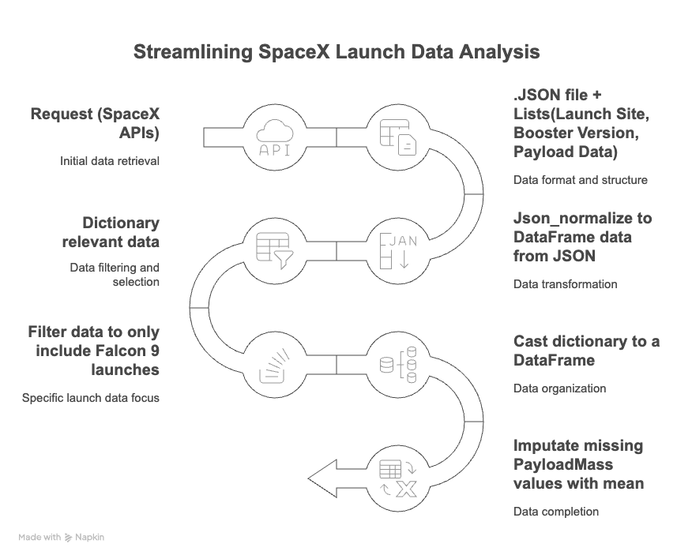
Data Collection – SpaceX API
Present your data collection with SpaceX REST calls using key phrases and flowcharts
GitHub URL of the completed SpaceX API calls notebook: https://github.com/williamwang-ty/ibm-ds-capstone/blob/main/Module1/Data%20Collection%20Api.ipynb

Slide 9
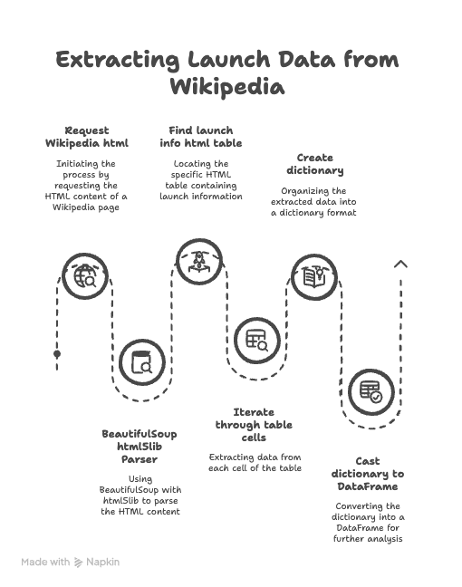
Data Collection - Scraping
Present your web scraping process using key phrases and flowcharts
GitHub URL of the completed web scraping notebook: https://github.com/williamwang-ty/ibm-ds-capstone/blob/main/Module1/Data%20Collection%20with%20Web%20Scraping.ipynb

Slide 10
Data Wrangling
Create a new training label column called class, where successful landings = 1 and failures = 0.
The Outcome column includes both Mission Outcome and Landing Location.
Label Mapping:
Assign 1 to: True ASDS, True RTLS, True Ocean
Assign 0 to: None None, False ASDS, None ASDS, False Ocean, False RTLS
GitHub URL:
https://github.com/williamwang-ty/ibm-ds-capstone/blob/main/Module1/Data%20wrangling.ipynb

Slide 11
EDA with Data Visualization
Exploratory Data Analysis (EDA) was performed on the following variables: Flight Number, Payload Mass, Launch Site, Orbit, Class, and Year.
Plots Used:
Flight Number vs. Payload Mass
Flight Number vs. Launch Site
Payload Mass vs. Launch Site
Orbit vs. Success Rate
Flight Number vs. Orbit
Payload vs. Orbit
Yearly Success Trend
Scatter plots, line charts, and bar plots were used to explore relationships between variables for potential use in the machine learning model.
GitHub URL:
https://github.com/williamwang-ty/ibm-ds-capstone/blob/main/Module2/EDA%20with%20Visualization.ipynb

Slide 12
EDA with SQL
Loaded the dataset into an IBM DB2 database and queried it using SQL through Python.
Queries were used to explore:
Launch site names
Mission outcomes
Customer payload sizes
Booster versions
Landing outcomes
GitHub URL
https://github.com/williamwang-ty/ibm-ds-capstone/blob/main/Module2/EDA%20with%20SQL.ipynb

Slide 13
Build an Interactive Map with Folium
Folium maps show launch sites, landing outcomes (success/failure), and proximity to key locations: railways, highways, coasts, and cities.
This helps explain launch site placement and visualizes landing success in relation to location.
Github URL：
https://github.com/williamwang-ty/ibm-ds-capstone/blob/main/Module3/Interactive%20Visual%20Analytics%20with%20Folium.ipynb

Slide 14
Build a Dashboard with Plotly Dash
The dashboard includes a pie chart and a scatter plot.
The pie chart shows the distribution of successful landings across all launch sites or by individual site.
The scatter plot filters by site (all or individual) and payload mass (0–10,000 kg slider).
The pie chart visualizes launch success rates, while the scatter plot reveals how success varies by launch site, payload mass, and booster version.
GitHub URL:
https://github.com/williamwang-ty/ibm-ds-capstone/blob/main/Module3/spacex_dash_app.py

Slide 15
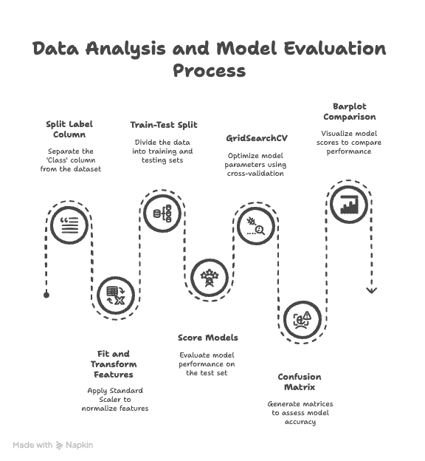
Predictive Analysis (Classification)
GitHub URL
https://github.com/williamwang-ty/ibm-ds-capstone/blob/main/Module4/Machine%20Learning%20Prediction.ipynb

Slide 16
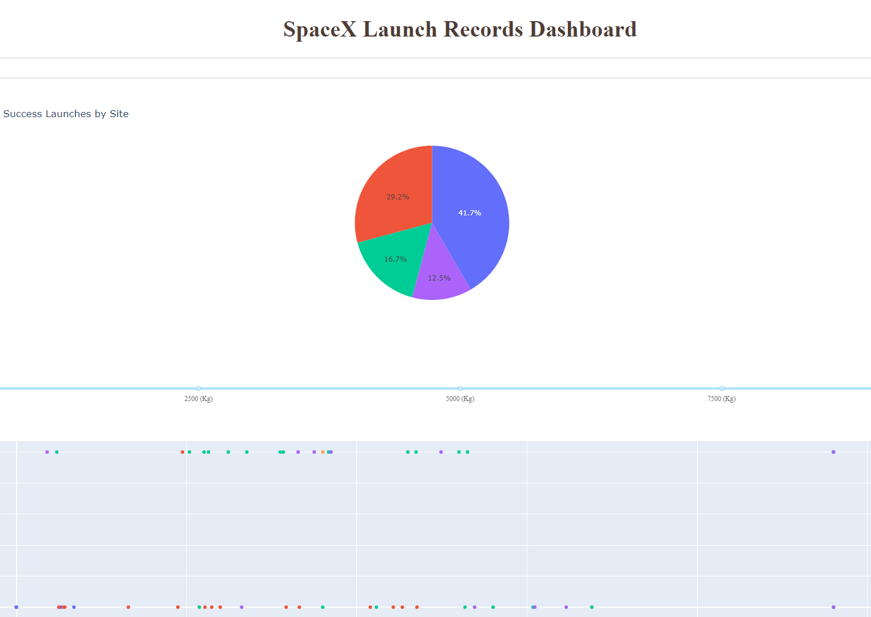
Results
This is a preview of the Plotly dashboard.
The next slides will cover:
EDA with visualizations
EDA using SQL
Interactive Folium map
Model results with ~83% accuracy

Slide 17

Section 2

Slide 18
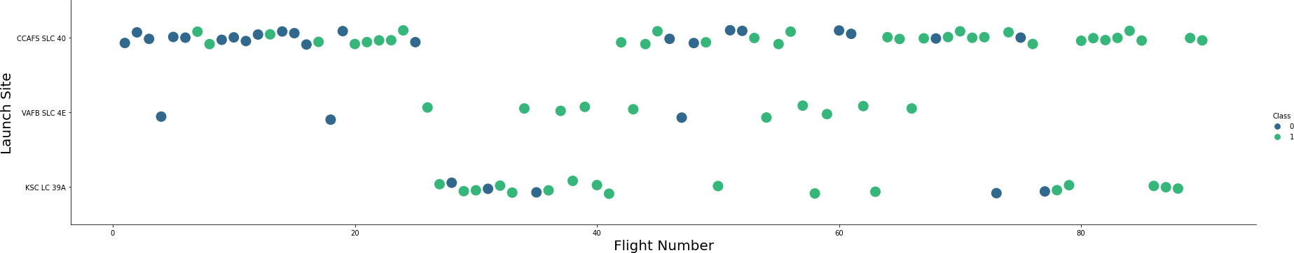
Flight Number vs. Launch Site
Green indicates successful launch; Purple indicates unsuccessful launch.
The graph shows a rising success rate over time, with a major improvement around Flight 20.
CCAFS is the primary launch site, handling the highest number of launches.

Slide 19
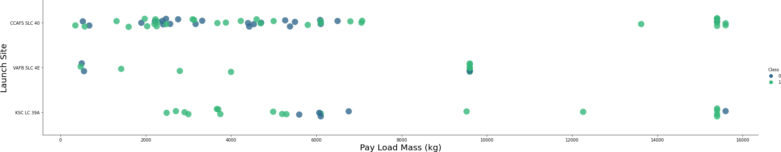
Payload vs. Launch Site
Green indicates successful launch; Purple indicates unsuccessful launch.
Most payloads range between 0–6000 kg, with variations across different launch sites.

Slide 20
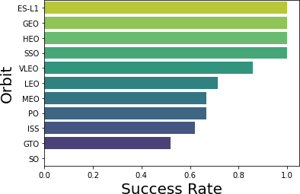
Success Rate vs. Orbit Type
ES-L1, GEO, HEO (1 each) and SSO (5) have a 100% success rate. VLEO (14) shows good success with more attempts. SO (1) has a 0% success rate. GTO (27) has the largest sample with about 50% success.

Slide 21
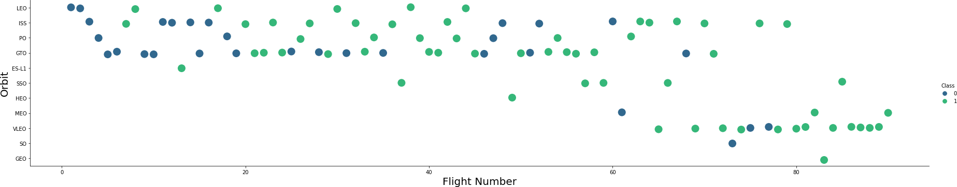
Flight Number vs. Orbit Type
SpaceX has shifted its orbital preferences over time, with launch outcomes correlating to these changes.
The company initially favored LEO orbits with moderate success, then moved to various orbital types, and recently returned to VLEO launches.
Performance data suggests SpaceX achieves better results in lower orbits and Sun-synchronous orbits.

Slide 22
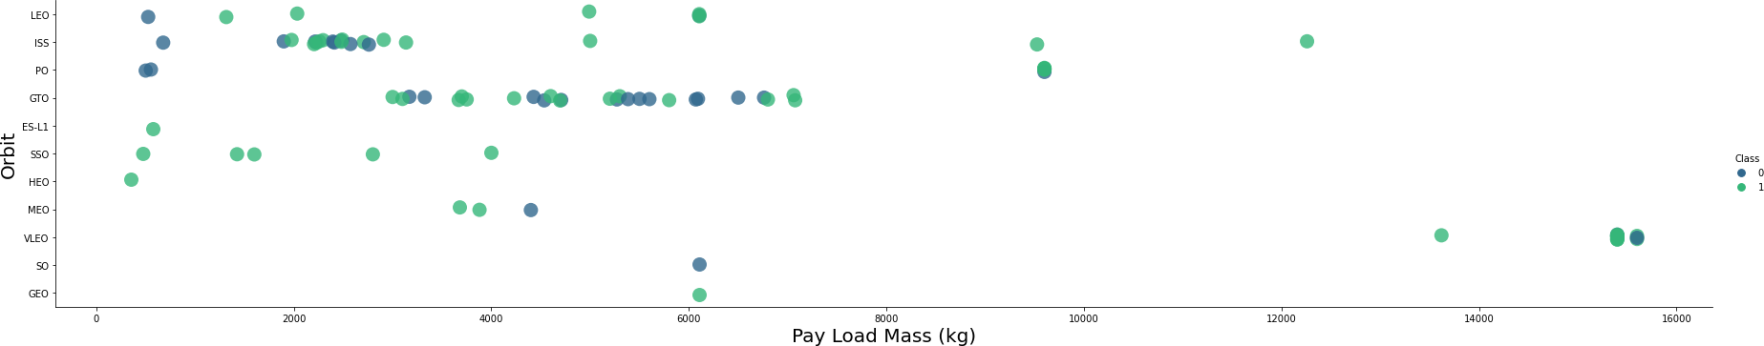
Payload vs. Orbit Type
Payload Mass and Orbit Correlation:
LEO and SSO missions typically carry lighter payloads with relatively low mass values
VLEO missions, despite being highly successful, exclusively handle heavier payloads in the upper mass range
Clear correlation exists between orbital destination and payload mass requirements

Slide 23
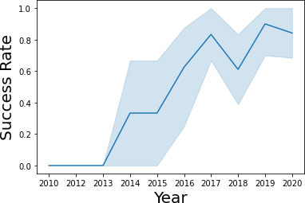
Launch Success Yearly Trend
Launch Success Trend:
Success rates have consistently improved since 2013, with only a minor decline in 2018
Recent years show approximately 80% success rate, indicating strong operational maturity

Slide 24
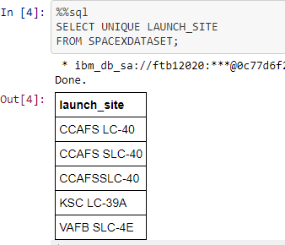
All Launch Site Names
• Database contains inconsistent naming for the same launch sites due to data entry errors
• CCAFS SLC-40, CCAFSSLC-40, and CCAFS LC-40 all represent the same Cape Canaveral launch facility
• Only 3 unique launch sites exist: CCAFS SLC-40, KSC LC-39A, and VAFB SLC-4E
• Data standardization needed to consolidate duplicate entries under consistent naming convention

Slide 25
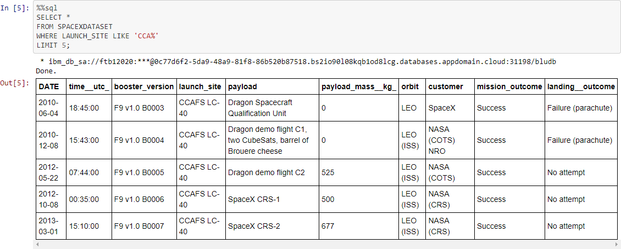
Launch Site Names Begin with 'CCA'

Slide 26
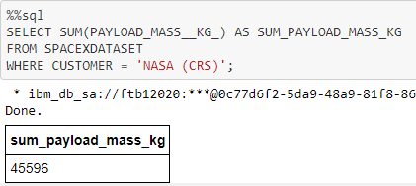
Total Payload Mass
• Query calculates total payload mass in kilograms for all NASA-contracted missions
• CRS (Commercial Resupply Services) missions specifically deliver cargo to the International Space Station
• NASA serves as the primary customer for ISS resupply operations through SpaceX's commercial launch services

Slide 27
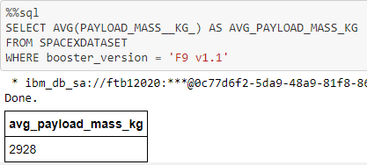
Average Payload Mass by F9 v1.1

Slide 28
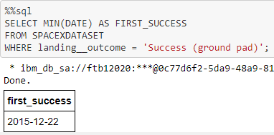
First Successful Ground Landing Date
• Query identifies the first successful ground pad landing occurred in late 2015
• Earlier successful landings began in 2014, but these were likely drone ship or other recovery methods
• Ground pad landings represented a significant technological advancement in SpaceX's reusability program

Slide 29
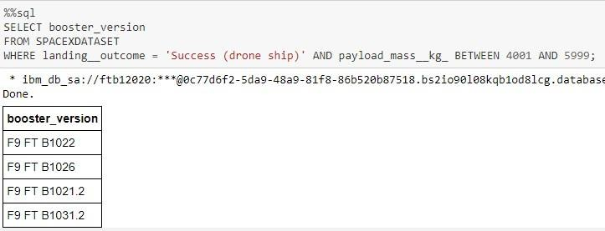
Successful Drone Ship Landing with Payload between 4000 and 6000
• Query identifies four specific booster versions that achieved successful drone ship landings
• These missions carried payloads between 4,000-6,000 kg (exclusive range)
• Demonstrates successful recovery capabilities across multiple booster iterations within a specific payload mass window

Slide 30
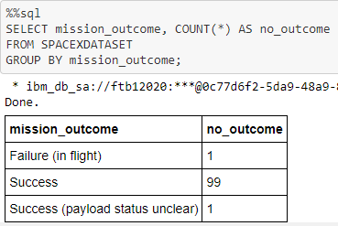
Total Number of Successful and Failure Mission Outcomes
• Query shows SpaceX achieves mission success nearly 99% of the time across all launches
• Most landing failures appear to be intentional, indicating mission success despite recovery attempts
• Database contains one launch with unclear payload status and one in-flight failure
• High success rate demonstrates SpaceX's operational reliability in primary mission objectives

Slide 31
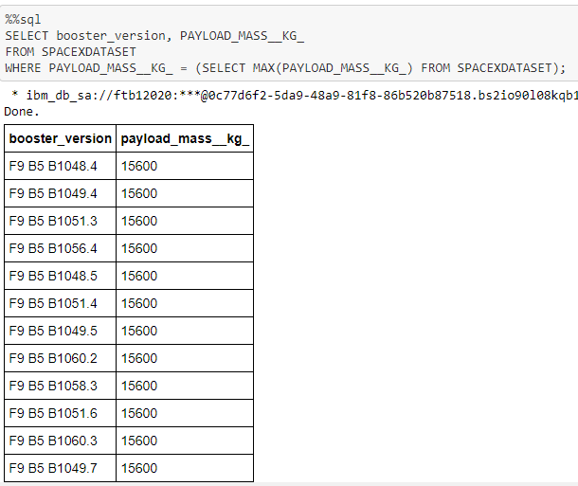
Boosters Carried Maximum Payload
• Query identifies booster versions that carried the maximum payload mass of 15,600 kg
• All heavy payload missions used F9 Block 5 boosters with B10xx.x designations
• Strong correlation exists between booster version capabilities and payload mass capacity
• Block 5 variants demonstrate superior performance for maximum weight missions

Slide 32
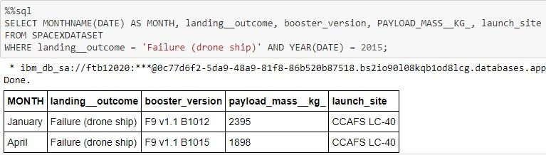
2015 Launch Records
• Query identifies two specific 2015 launches where Stage 1 failed to land successfully on drone ships
• Results include complete mission details: launch month, landing outcome, booster version, payload mass, and launch site
• These failures represent early attempts at autonomous drone ship recovery technology development

Slide 33
Rank Landing Outcomes Between 2010-06-04 and 2017-03-20
• Query covers successful landings between June 4, 2010 and March 20, 2017 (inclusive)
• Two successful landing types achieved: drone ship landings and ground pad landings
• Total of 8 successful recoveries accomplished during this developmental timeframe
• Represents SpaceX's early mastery of reusable rocket recovery technology

Slide 34

Section 3

Slide 35

Lauch Site Locations
The left map displays all U.S. launch sites relative to the country’s outline.
The right map zooms in on Florida’s two closely located launch sites.
All sites are coastal.

Slide 36

Launch Markers
Folium map clusters, when clicked, show successful landings (green icons) and failed landings (red icons).
For example, VAFB SLC-4E displays 4 successful and 6 failed landings.

Slide 37



Key Location Proximity
Using KSC LC-39A as an example, launch sites are strategically located near railways and highways for efficient transport of large components and personnel.
They are also positioned close to coasts and farther from cities, allowing failed launches to land safely in the sea, minimizing risks to populated areas.

Slide 38

Section 4

Slide 39

Successfully Launched Across All Sites
Here's a breakdown of successful landing distribution by launch site:
CCAFS SLC-40 and KSC have an equal number of successful landings.
Most successful landings at CCAFS occurred before its name change from LC-40.
VAFB has the fewest successful landings, possibly due to a smaller sample size and the increased difficulty of west coast launches.

Slide 40

Highest Launch Success Rate Site
KSC LC-39A: highest success rate (10 successful, 3 failed landings).

Slide 41

Payload Mass & Success by Booster Version
Key observations from the Plotly dashboard:
The payload range selector is set to 0-10,000, but the maximum payload is 15,600.
The scatter plot indicates successful landings with '1' and failures with '0'.
Booster version categories are represented by color and launch count by point size.
In the 0-6000 kg payload range, there are two failed landings with zero kg payloads.

Slide 42

Section 5

Slide 43

Classification Accuracy
The provided models demonstrated nearly identical performance on the test set, achieving an accuracy of 83.33%. However, it is crucial to acknowledge the limited size of the test set, comprising only 18 samples. This small sample size can lead to significant variability in accuracy, as observed with the Decision Tree Classifier model across multiple runs. Consequently, a larger dataset is likely necessary to definitively identify the optimal model.

Slide 44

Confusion Matrix
Correct predictions lie on the top-left to bottom-right diagonal.
Since all models achieved identical test set results, they produced a single confusion matrix with the following key figures:
True Positives: 12 (Successful landings correctly predicted)
True Negatives: 3 (Unsuccessful landings correctly predicted)
False Positives: 3 (Unsuccessful landings incorrectly predicted as successful)
The presence of these 3 false positives highlights a clear tendency for the models to over-predict successful landings.

Slide 45
Conclusions
We developed a machine learning model for Space Y to predict SpaceX Stage 1 landing success, aiming to enhance competitiveness and potentially save ~$100 million USD per launch.
Project Highlights:
Data: Sourced from the SpaceX API and Wikipedia.
Process: Involved data labeling, DB2 storage, and dashboard visualization.
Result: Achieved an 83.33% accurate prediction model.
Value & Application:
This model enables Space Y to assess landing risks before launch, facilitating more cost-effective decisions.
Future Recommendations:
Due to the limited test set size, we recommend collecting more data to further refine the model and improve accuracy.

Slide 46
Appendix
GitHub URL：
https://github.com/williamwang-ty/ibm-ds-capstone

Slide 47


